Slide 1
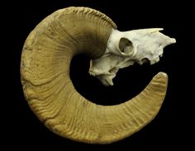
Bighorn Sheep Adaptations
412 Pronghorn Trail – Bozeman, MT
www.wildsheepfoundation.org

Slide 2
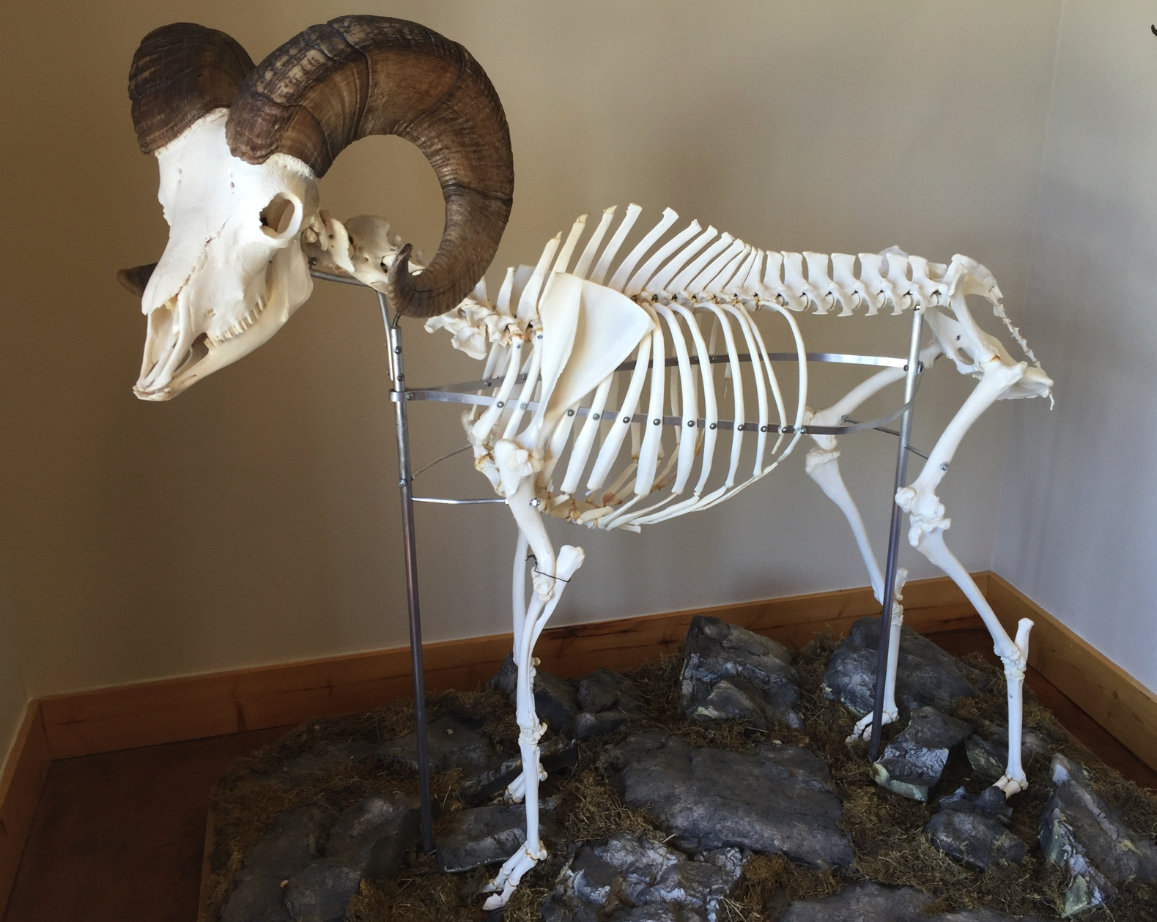
The bighorn sheep is actually a smaller animal than most people think. The height of the shoulder is usually between 80-100 cm. Stand up and see how you compare to a meter stick at 100cm.

Slide 3
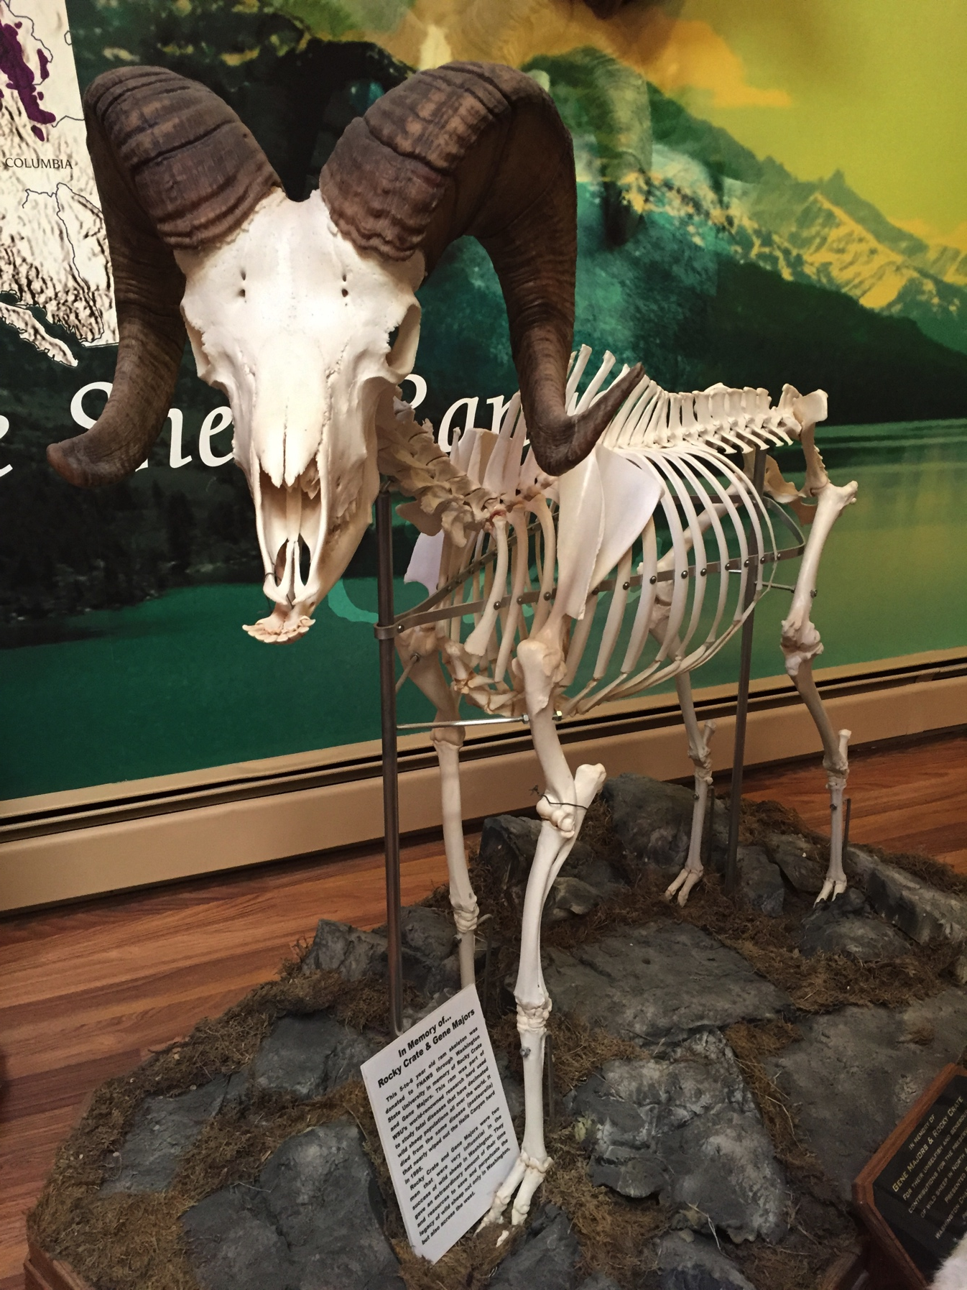
The massive horns on the head often give the impression that the bighorn sheep is a much larger animal.
Comparing this to the basic mule deer, which stands at the shoulder between 91cm to 107 cm (bighorn is 80-100 cm)
Average mule deer weigh 130-280 pounds, where as an average bighorn sheep weighs 99-297 pounds.
So, the bighorn is very comparable to the size of mule deer.

Slide 4
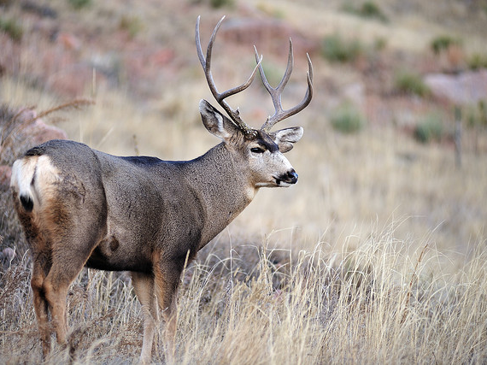
Mule Deer

Slide 5
The bighorn’s skull (as well as thin horns) has some wonderful adaptations that help it survive.
Above their brain are honeycomb pockets that help to absorb the impact force from when they ram heads during the rut (mating season).
Under the sheath of the horn, which is made of keratin like your fingernails, lies a bone core. This bone core is also like a honeycomb, similar to a solid sponge.
This of these adaptations like a football players helmet. Inside the helmet are many pads that help protect the football players head.

Slide 6
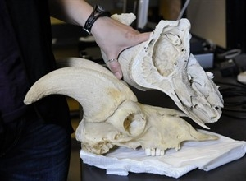
Brain cavity
Honeycomb pockets
Honeycomb bone core
Cross section of a bighorn skull.

Slide 7
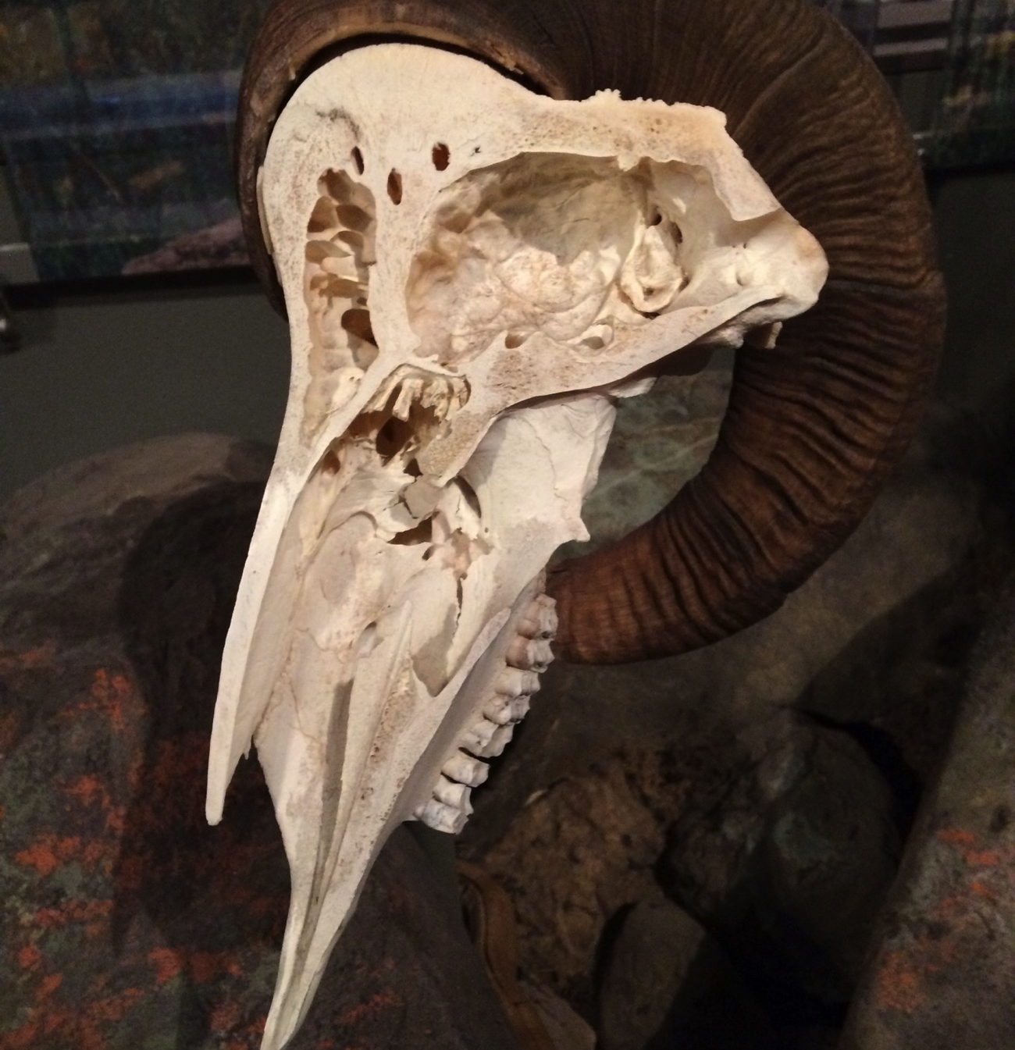
Brain cavity
Honeycomb pockets
Spinal cord exits here
Olfactory system entrance (nose)

Slide 8

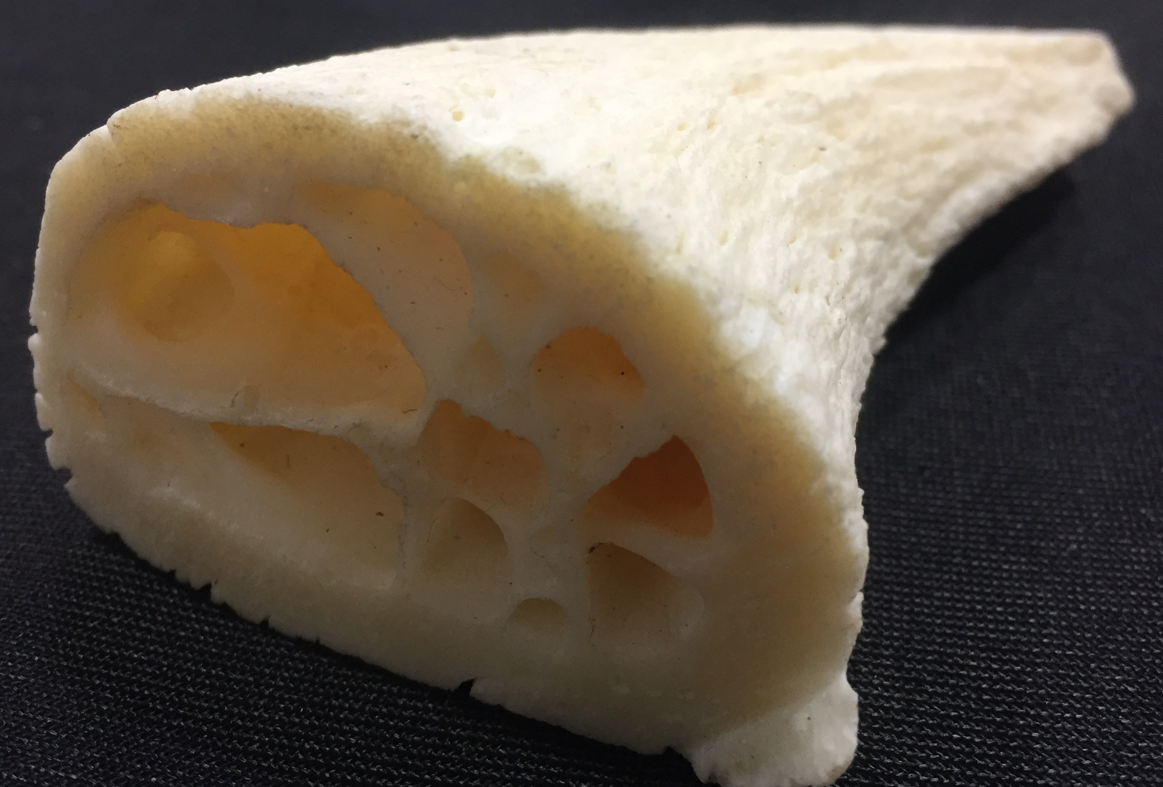
Inside bone under
horn

Slide 9
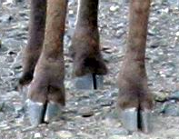
Hooves:
  Harder outer shell and soft inner, making them flexible and therefore helping sheep when climbing over precarious terrain.
  Each hoof has two toes which can spread wide when jumping on rocks for better balance.
  Rough pads on the bottom of the hoof help to grip the surface of the rocks as well

Slide 10
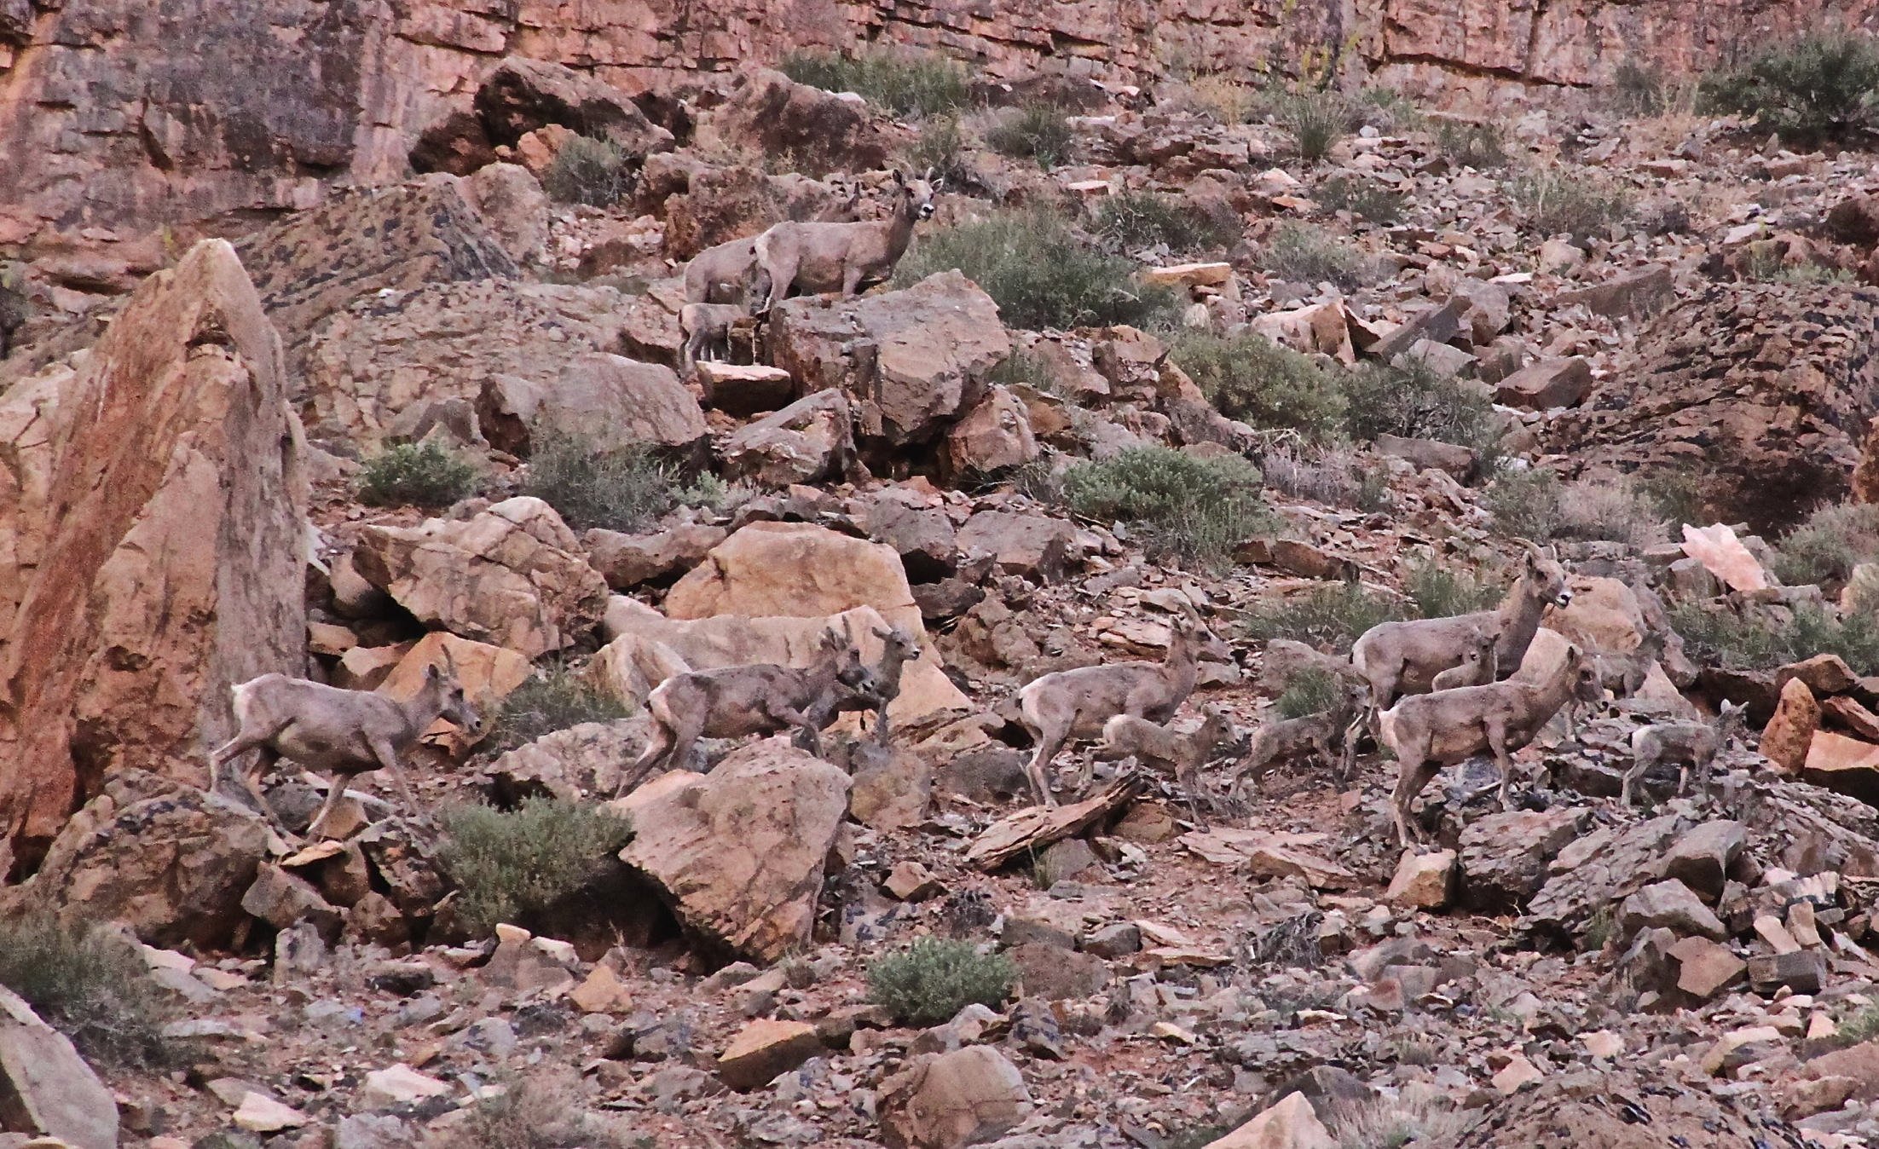
Camouflage
How many bighorn can you find?

Slide 11
There are 13 sheep.
Camouflage helps them blend in, making it harder for predators to see them.

Slide 12
Camouflage
Did you find them all?
3
3
2
2
1
1
1

Slide 13
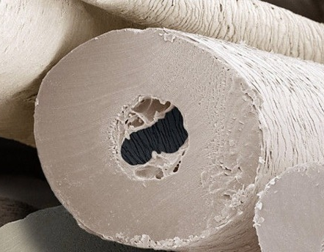
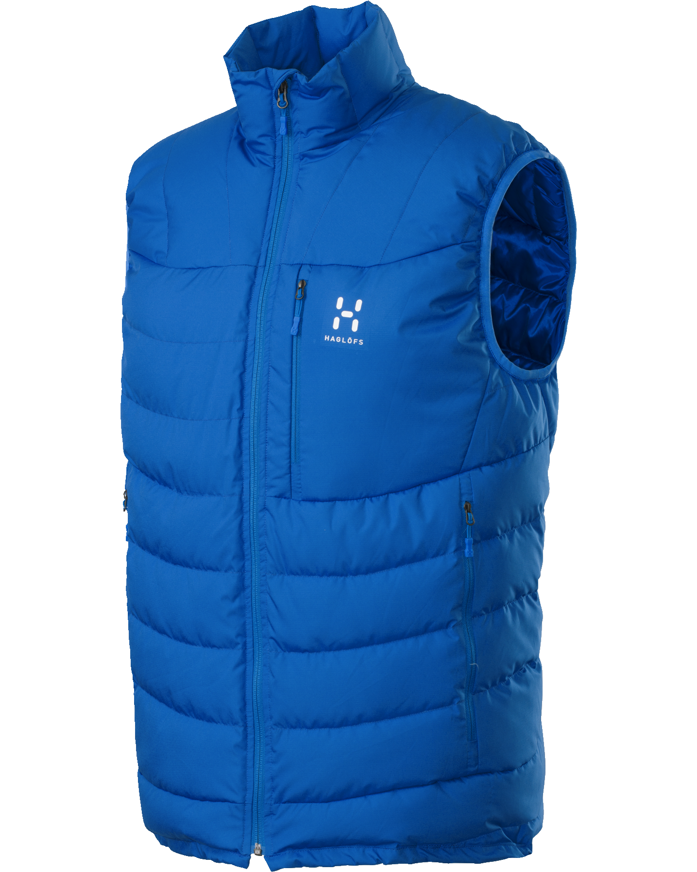
Like deer, antelope and elk, wild sheep hairs are somewhat hollow. Air is trapped inside, creating the insulating feature. Similar to double pain windows, down comforters, or down vests, this helps them stay warmer in the winter and cooler in the summer.

Slide 14
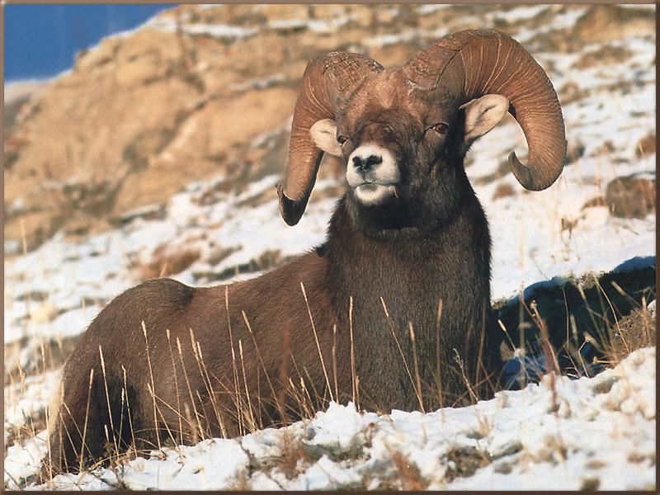
Wild sheep are ruminants, having 4 chambers to their stomach like cows. They don’t chew their food when first eaten, but instead these “cud chewers” gobble up food fast while out in the open, and regurgitate it to chew later while they are relaxed and protected.

Slide 15
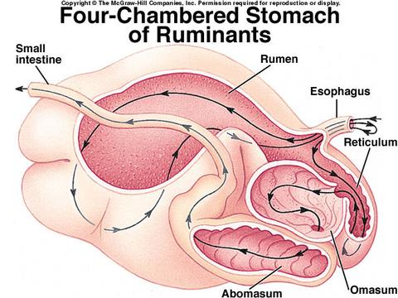

Slide 16

This video shows a wild sheep swallowing its food and then regurgitating other food to chew again….demonstrating what ruminants do (watch cows out in a field sometime).

